Slide 1
ROBIN COLLINS
“A SCIENTIFIC ARGUMENT FOR THE EXISTENCE OF GOD: THE FINE-TUNING DESIGN ARGUMENT”

Slide 2
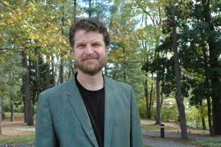
ROBIN COLLINS

Slide 3
AN INFORMAL ANALOGY
SUPPOSE WE FIND A FULLY FUNCTIONING BIOSPHERE ON MARS. WE WOULD CONCLUDE THAT IT WAS DESIGNED BY SOME INTELLIGENT BEINGS.
THIS IS NOT COMPLETELY ANALOGOUS. IN THAT CASE, WE KNOW SOMETHING ABOUT BIOSPHERES ALREADY (COMPARE WILLIAM PALEY’S WATCH – ARGUMENT FROM DESIGN).
THERE IS SOME ANALOGY WITH THE UNIVERSE. BUT EVALUATING ANALOGIES IS A TRICKY,
DELICATE , AND INTUITIVE BUSINESS.

Slide 4
ARGUMENTS FROM DESIGN
AN ARGUMENT FOR THE EXISTENCE OF GOD BASED ON THE APPARENT DESIGN IN THE UNIVERSE OR IN LIVING ORGANISMS IS AN ARGUMENT FROM DESIGN. THE SUCCESS OF DARWIN’S THEORY OF EVOLUTION HAS SERIOUSLY WEAKENED (SOME THINK, DESTROYED) THE FORCE OF THE LATTER VERSIONS (SEE RICHARD DAWKINS, DANIEL DENNETT. ALSO SEE PLANTINGA FOR ATTEMPTED REBUTTALS AND COUNTER-ARGUMENTS).

Slide 5
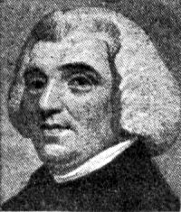
WILLIAM PALEY (1743 -1805)

Slide 6
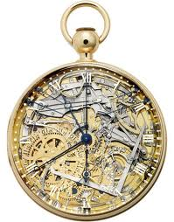
PALEY USED A WATCH

Slide 7
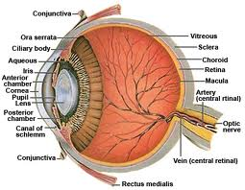
AND COMPARED IT TO THE HUMAN EYE

Slide 8
COLLINS USES THE LAWS OF NATURE
MANY PHYSICISTS AGREE WITH COLLINS ABOUT THIS

Slide 9
THERE ARE (0R WERE) SOME VERY FAMOUS PHYSICISTS-ATHEISTS
RICHARD FEYNMAN
P. A. M. DIRAC
STEVEN WEINBERG

Slide 10
“WAIT! HAVE WE JUST COMMITED THE FALLACY OF ARGUMENT FROM AUTHORITY?”
NO. WE HAVEN’T !! HERE IS A DEFINITION OF THE FALLACY OF (FALSE) AUTHORITY.

Slide 11
THE FALLACY OF ARGUMENT FROM (FALSE) AUTHORITY
Def: An argument commits THE FALLACY OF ARGUMENT FROM AUTHORITY =DF The argument is of the form: “X testifies that P. So, P is thereby confirmed ”, BUT our evidence contains nothing positively relevant to X’s expertise with respect to P

Slide 12
IN OUR CASE THE EXPERTS CITED ARE ALL WELL-KNOWN PHYSICISTS
THE PEOPLE CITED ARE EXPERTS ON THE LAWS OF PHYSICS, THE EVIDENCE FOR SUCH LAWS AND THE FORM OF THE LAWS. THEY CLAIM TO FIND APPARENT DESIGN WITH RESPECT TO RANGE OF THE CONSTANTS ALLOWING HUMAN LIFE. THEY ARE NOT, IN THIS CASE, “FALSE AUTHORITIES.” [ YOUR PERSONAL KNOWLEDGE OF THESE THINGS WOULD OF COURSE BE STRONGER EVIDENCE (FOR YOU)].

Slide 13
COLLINS ARGUES THAT THE FINE-TUNING EVIDENCE CONFIRMS THE HYPOTHESIS OF THEISM MORE THAN THE ATHEISTIC UNIQUE- UNIVERSE HYPOTHESIS
HE ALSO ARGUES, INDEPENDENTLY, THAT THE ATHEISTIC MANY-UNIVERSES HYPOTHESIS “OUGHT TO BE REJECTED.” HE SHOULD SAY: “CERTAIN THINGS COUNT STRONGLY AGAINST THIS HYPOTHESIS AS COMPARED TO THE HYPOTHESIS OF THEISM.

Slide 14
HIS ARGUMENT IS DEDUCTIVELY VALID, BUT ITS CONCLUSION IS THAT ONE THING (THEISM) IS MADE MORE PROBABLE THAN AN ATHEISTIC HYPOTHESIS
THIS MAY BE CONFUSING. THE ARGUMENT HE GIVES IS SUPPOSED TO BE (AND IS) DEDUCTIVELY VALID. BUT THE CONCLUSION CONCERNS INDUCTIVE SUPPORT!

Slide 15
COLLINS’S ARGUMENT USES “THE PRIME PRINCIPLE OF CONFIRMATION”
HIS DEDUCTIVELY VALID ARGUMENT
CONCERNS ONLY THE ATHEISTIC UNIQUE UNIVERSE HYPOTHESIS (AND THE THEISTIC HYPOTHESIS). IT DOESN’T CONCERN , AND HAS NOTHING TO DO WITH, THE ATHEISTIC MANY-UNIVERSES HYPOTHESIS.

